Slide 1
Mini Popper | Colt poppers | Pepper poppers | Plates | Wall feet
4 | 3 | 1 | 0 | 65
Bay | Stage | Target Type | Count | NS | Total | Hard Cover
A3 | Fishhook | IPSC | 12 | 2 | 14 | 1 Tux 2 Right Diag
A2 | Ship It | IPSC | 7 | 2 | 9 | 1 Tux 1 Left Diag
B1 | Calling All Angles | USPSA | 7 | 2 | 9 | 1 Tux
B2 | No Time Like the Present | USPSA | 8 | 1 | 9
B3 | 03-08 | USPSA | 7 | 4 | 11
B4 | Short | IPSC | 5 | 1 | 6

Slide 2
Prop | Stage

Slide 3

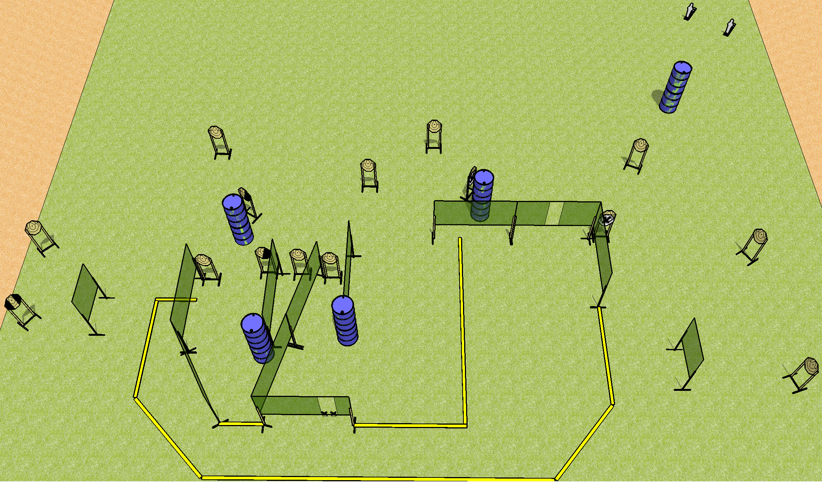
 | Dothan Practical Shooters – USPSA Match Fishhook Course Designer : Drew Coleman Bay: A2
Round Count 32 rounds 15 IPSC 2 mini poppers
Equipment List 21 wall feet 2 right diag, 1 tux 14 targets (12 + 2NS)

Slide 4
Fishhook
Written Stage Briefing
Scoring: Comstock Rounds: 32
Targets: 15 IPSC, 2 steel
Handgun start position: hands touching marks. Handgun is loaded and holstered.
PCC start position: stock on belt, muzzle touching either mark. Loaded carbine is held with both hands, safety on.
Stage Procedure: on the audible start signal, engage targets as they become available from within the shooting area.

Slide 5
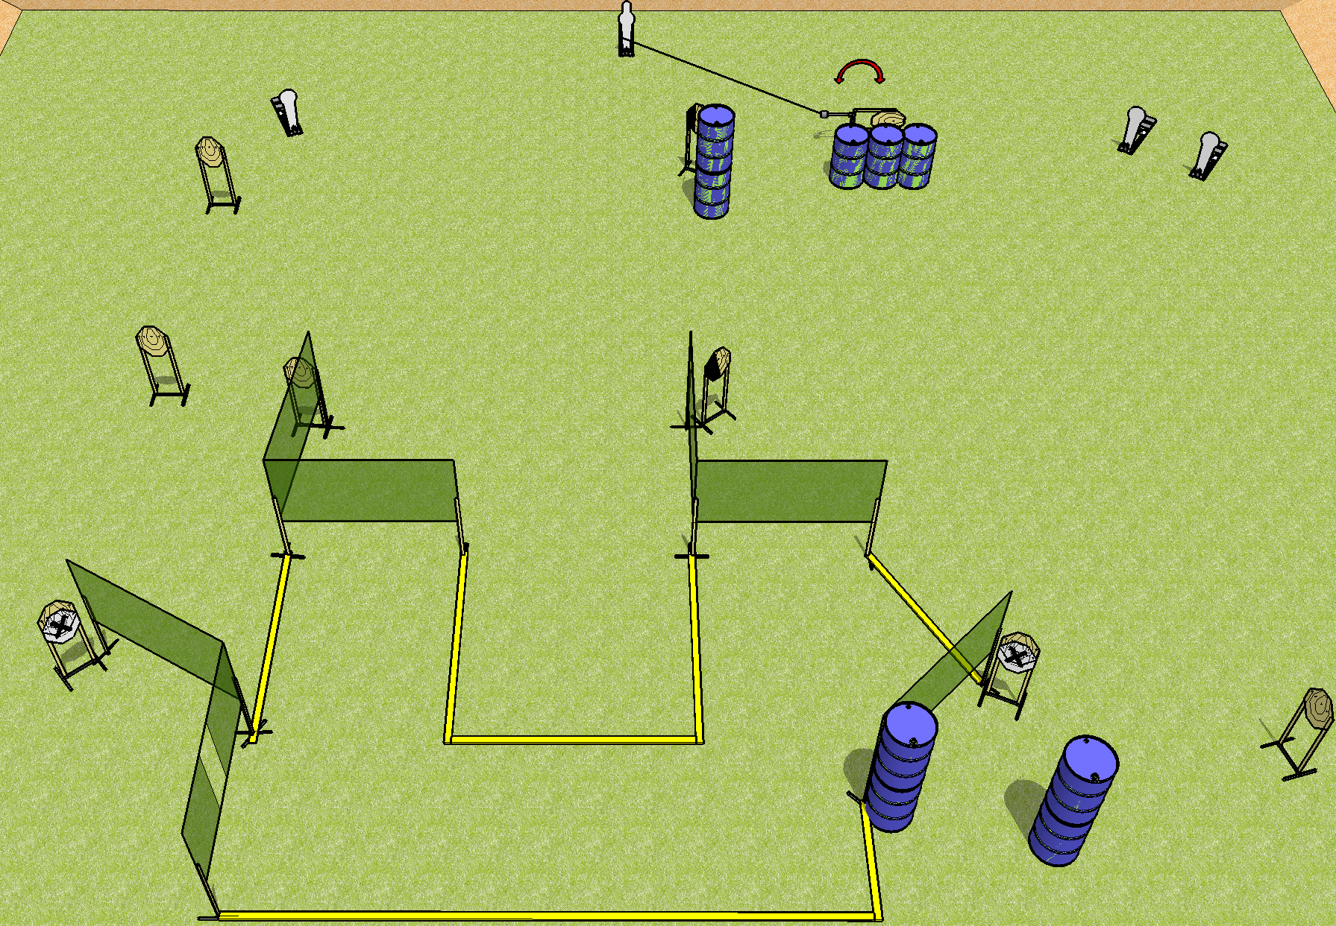
 | Dothan Practical Shooters – USPSA Match Ship It Course Designer : Drew Coleman Bay: A2
Round Count 22 rounds 9 IPSC 1 pepper popper, 3 colt poppers
Equipment List 12 wall feet Swinger + cable + fall forward popper 1 left diag, 1 tux 9 targets (7 + 2NS)

Slide 6
Ship It
Written Stage Briefing
Scoring: Comstock Rounds: 22
Targets: 9 IPSC, 4 steel
Handgun start position: anywhere inside the shooting area, wrists below belt. Handgun is loaded and holstered.
PCC start position: anywhere inside the shooting area, stock on belt. Loaded carbine is held with both hands, stock on belt, safety on.
Stage Procedure: on the audible start signal, engage the targets as they become available from within the shooting area. The swinger is activated by the pepper popper and remains visible at rest.

Slide 7
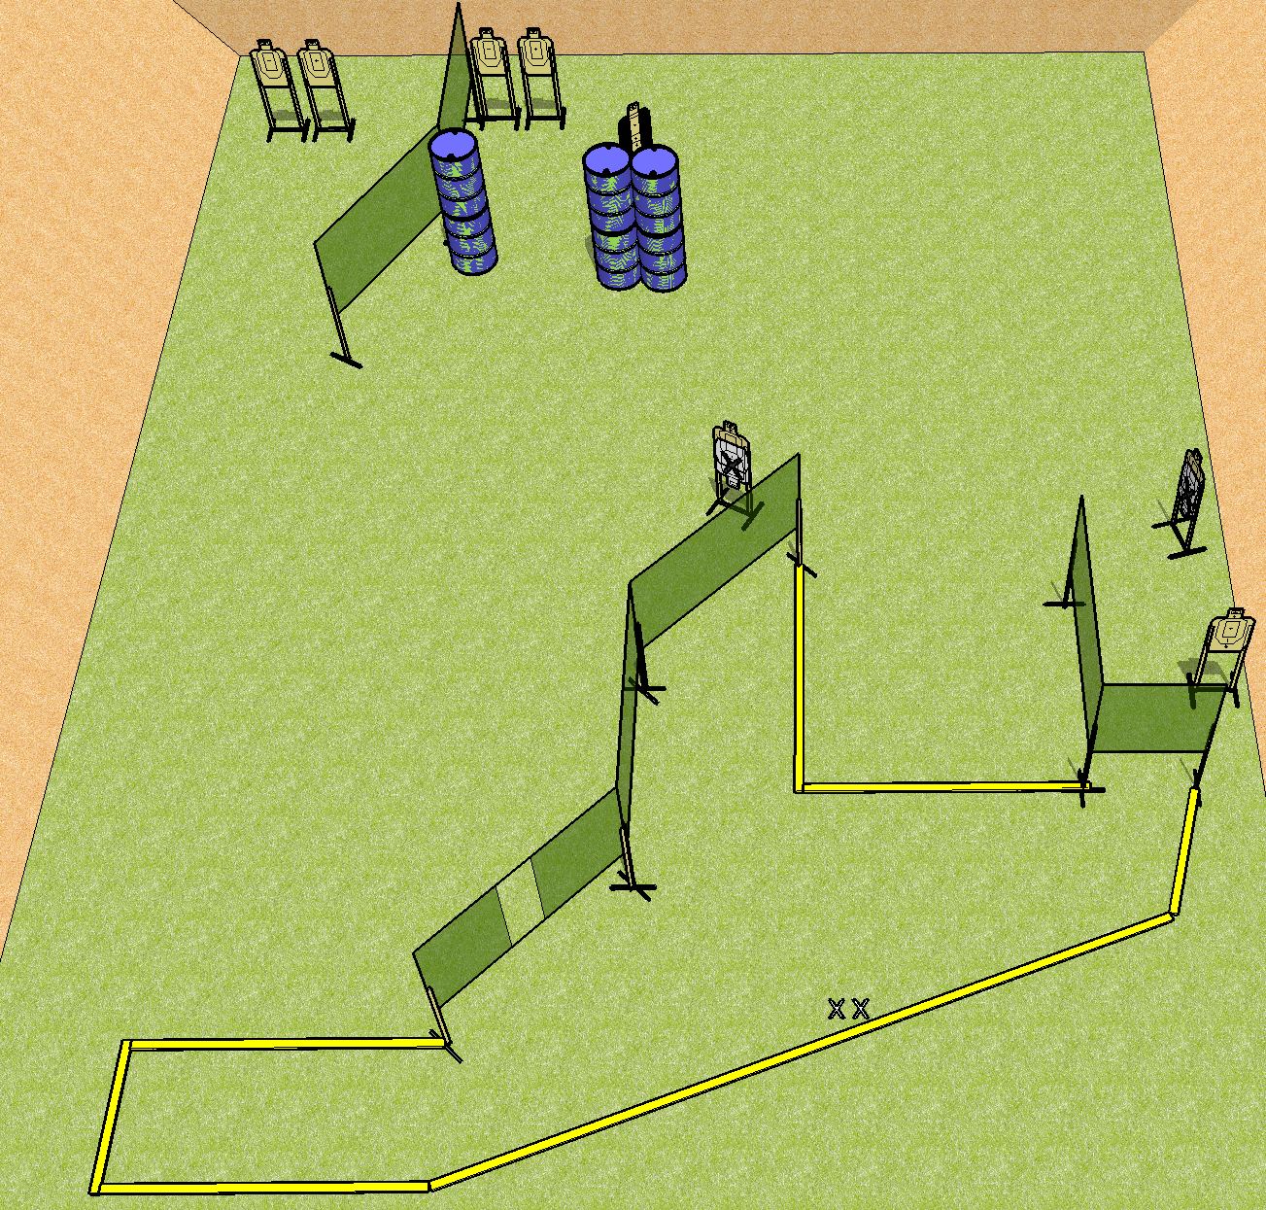
 | Dothan Practical Shooters – USPSA Match Calling All Angles Course Designer : Drew Coleman Bay: B1
Round Count 16 rounds 8 USPSA
Equipment List 13 wall feet 1 tux 9 targets (7 + 2NS)

Slide 8
Calling All Angles
Written Stage Briefing
Scoring: Comstock Rounds: 18
Targets: 9 USPSA
Handgun start position: feet on X’s, wrists below belt. Handgun is UNLOADED and holstered.
PCC start position: feet on X’s. UNLOADED carbine held with both hands, stock on belt
(unloaded = no magazine, empty chamber, hammer down)
Stage Procedure: on the audible start signal, engage targets as they become available from within the shooting area.

Slide 9
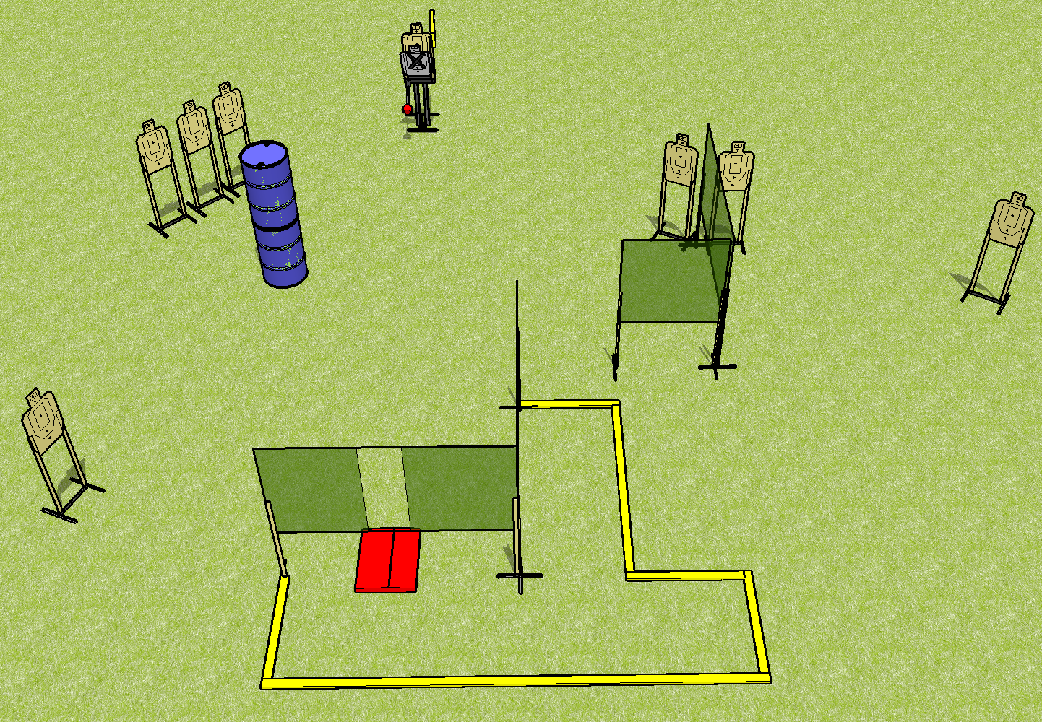
 | Dothan Practical Shooters – USPSA Match No Time Like the Present Course Designer : Drew Coleman Bay: B2
Round Count 16 rounds 8 USPSA
Equipment List 6 wall feet Stomp pad + max trap 8 targets + 1 NS

Slide 10
Stage Name
Written Stage Briefing
Scoring: Fixed Time - ___ seconds Rounds: 16
Targets: 8 USPSA
Handgun start position: anywhere inside the shooting area, wrists below belt. Handgun is loaded and holstered.
PCC start position: anywhere inside the shooting area, stock on belt. Loaded carbine is held with both hands, safety on.
Stage Procedure: on the audible start signal, engage each target with only 2 rounds each from within the shooting area. The max trap is activated by the stomp pad and is visible prior to and after activation

Slide 11
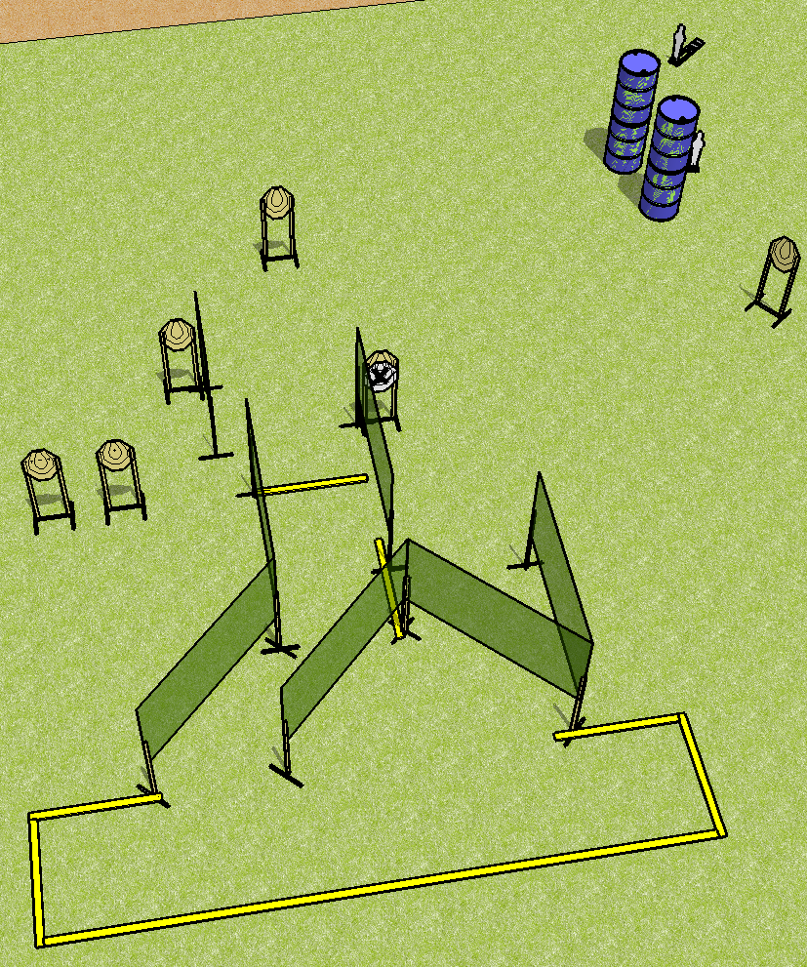
 | Dothan Practical Shooters – USPSA Match Short Course Designer : Drew Coleman Bay: B4
Round Count 12 rounds 5 IPSC 2 mini poppers
Equipment List 13 wall feet 5 targets + 1 NS

Slide 12
Short
Written Stage Briefing
Scoring: Comstock Rounds: 12
Targets: 5 IPSC, 2 steel
Handgun start position: straddling start stick, wrists below belt. Handgun is loaded and holstered.
PCC start position: straddling start stick, stock on belt. Loaded carbine is held with both hands, safety on.
Stage Procedure: on the audible start signal, engage targets as they become available from within the shooting area.

